Slide 1



Personal Finance Tracker
Name: Kavya Patel: 42302880501023
Janvi Kalani: 42302880501018

Slide 2




Project Analysis
Income Management
Expense Tracking
PROJECT
Budget Planning
Savings Goals
Summary
Financial Reports

Slide 3

Recap of Project
What is the Personal Finance Tracker?
Key Features of the Project
It allows users to track income, expenses, and savings in a structured and organized way.
The system provides a user-friendly interface to monitor financial health.
✔️ User Authentication
✔️ Expense Tracking
✔️ Income Management
✔️ Dashboard

Slide 4
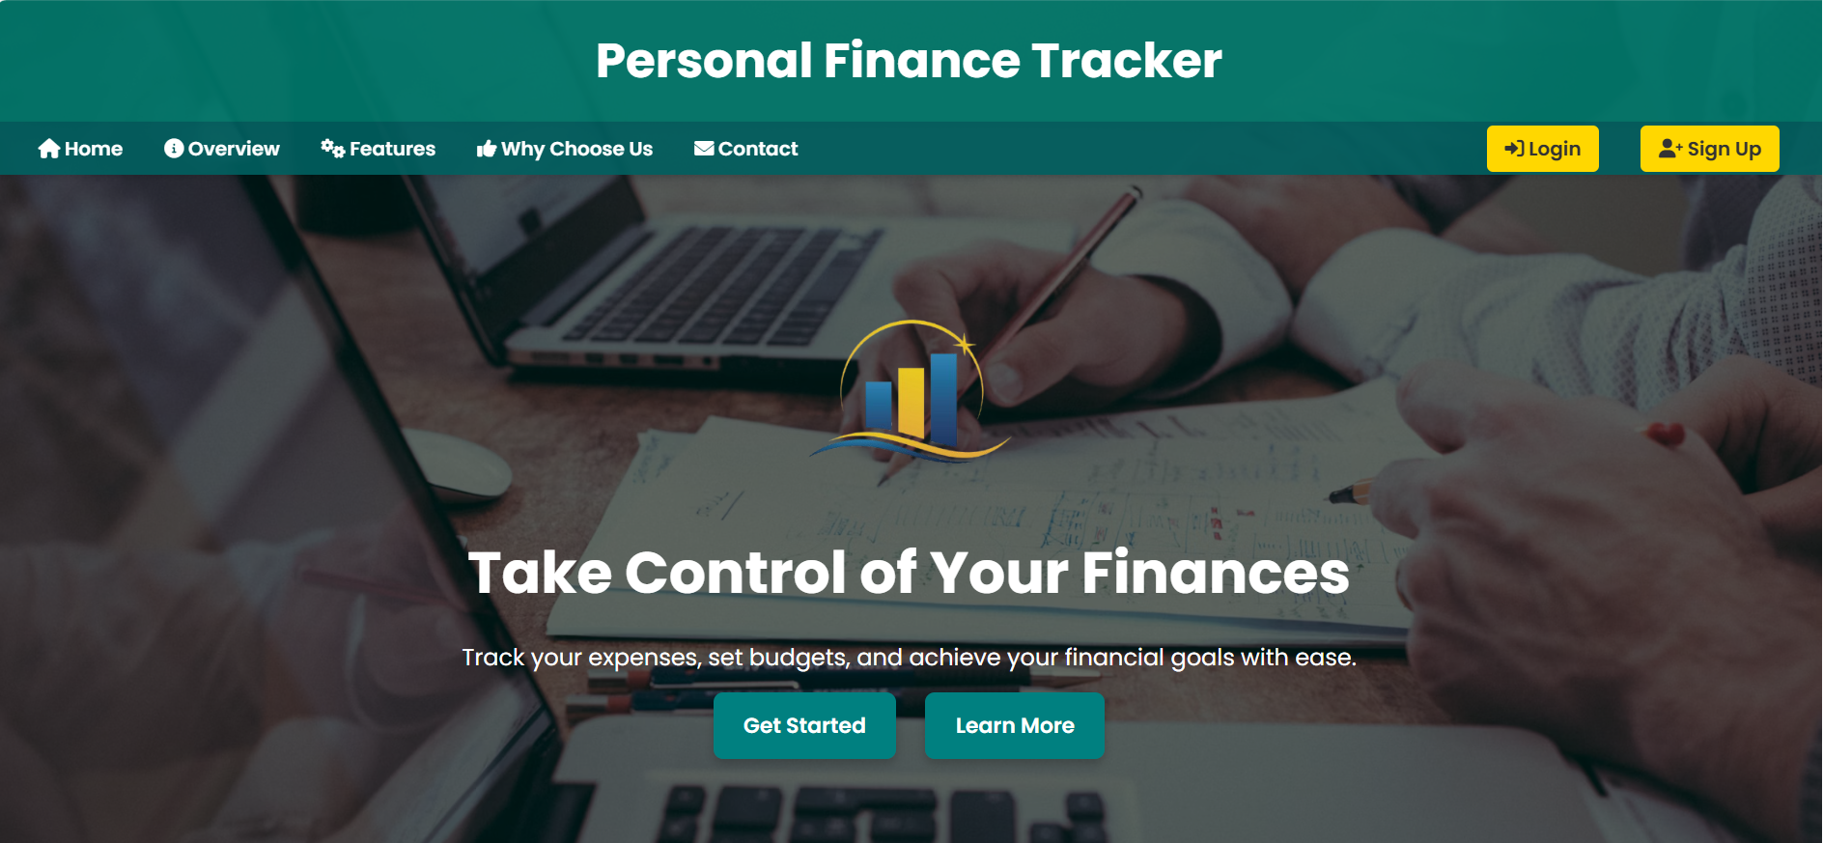
Home Page
Designed an interactive and responsive homepage.
Contains navigation links to Login, Signup, Overview, Features, and contact us.
Provides an overview of the project’s purpose.

Slide 5
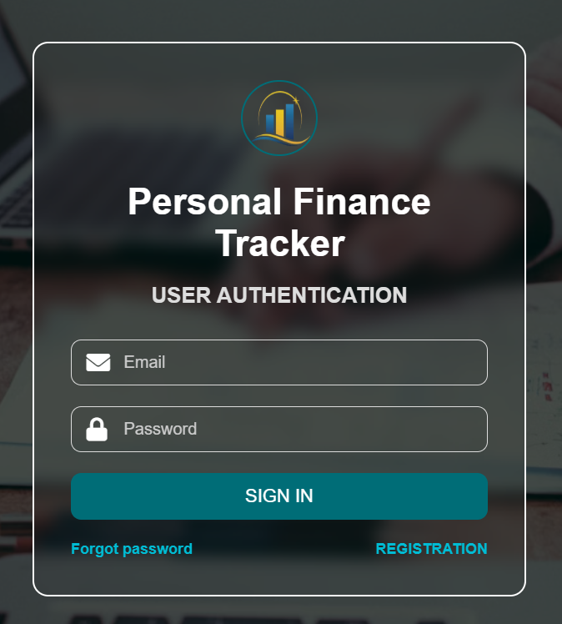
Login Page
Created a clean and user-friendly Login Page UI.
Includes input fields for Email and Password.
Designed a "Forgot Password?" link for future enhancements.

Slide 6
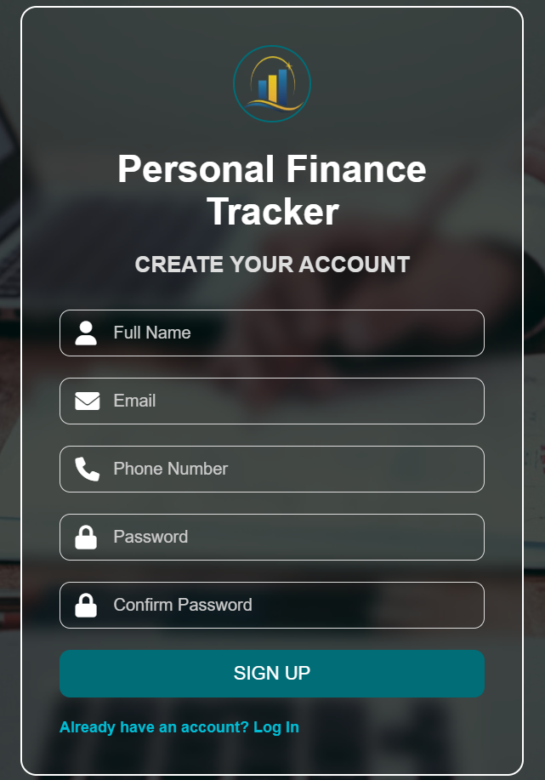
Signup Page
Developed a structured Signup Page UI.
Includes fields for Full Name, Email, Phone No, Password, and Confirm Password.
Ensures a seamless user registration process.
6

Slide 7
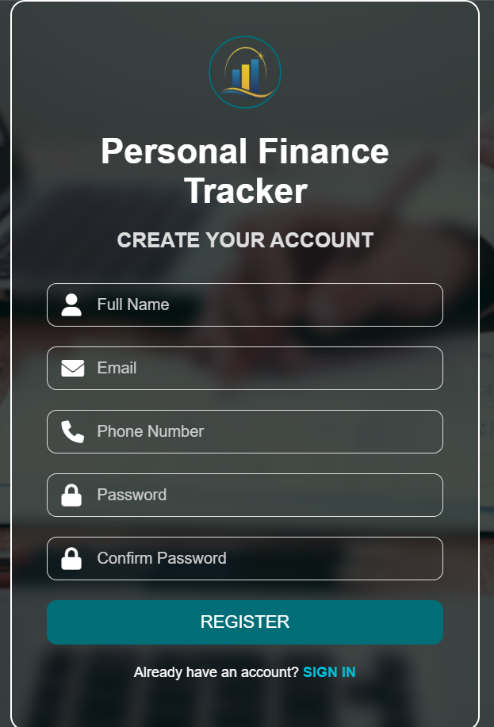
Registration Page
Developed a structured Registration Page UI.
Includes essential fields for Full Name , Email, Phone Number, Password & Confirm Password.
Ensures a seamless and secure user registration process completed.
7
7

Slide 8
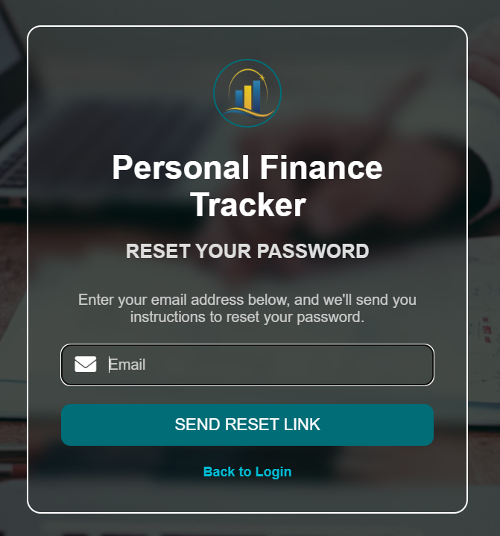
Forgot Password
Allows users to securely reset their password.
Includes for Email input field, "Send Reset Link" button, Option to return to Login page.
Ensures a seamless and secure password recovery process.
8
8
8

Slide 9
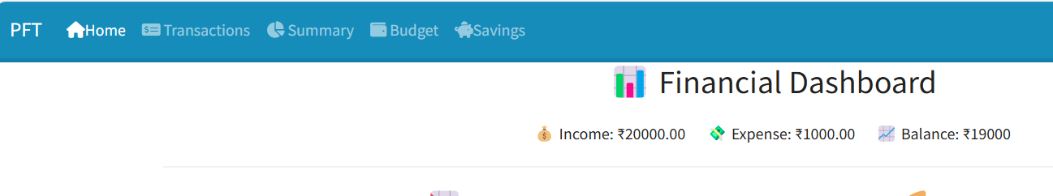
Dashboard
Home: Displays the main financial dashboard.
Transactions: Lists all income and expense records.
Summary: Provides an overview of financial trends.
Budget: Helps in setting and tracking spending limits.
Savings: Monitors progress towards financial goals.
9
9
9
9

Slide 10
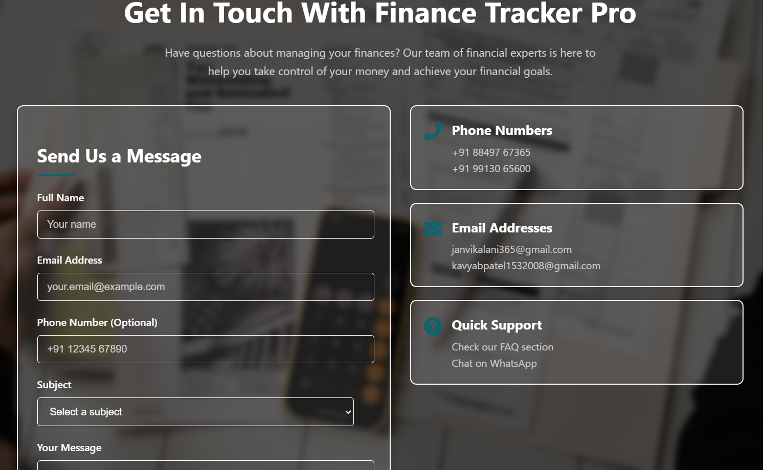
Contact us Page
Provides an easy way for users to contact support for financial queries.
Includes fields for name, email, phone number, subject, and message submission.
Offers quick support via phone, email, and WhatsApp for instant assistance.
10
10
10
10

Slide 11
Future Goals
🚀 Implementing the Dashboard
Provide an interactive interface for adding and tracking transactions.
Use advanced graphs and charts for financial insights.
Investment Tracking: Keep an eye on stocks and mutual funds.
Better Budgeting: Set and adjust budgets with smart predictions.
11
11
11
11
11

Slide 12
Conclusion
Manage Money Easily: Track income, expenses, and savings in one place.
Better Budgeting: Understand spending habits and control finances.
Reach Your Goals: Save money, invest wisely, and reduce debt.
Stay Organized: Keep finances secure and well-managed.
Build a Strong Future: Plan ahead for financial success.
12
12
12
12
12
12

Slide 13
Technologies Used
💻 Frontend:
HTML, CSS, JavaScript for responsive UI.
🛠 Backend:
PHP for server-side processing.
📂 Database:
MySQL for storing user & project data.
13
13
13
13
13

Slide 14
THANK YOU!

